Slide 1
Dunder Mifflin Infinity 2.0
E. Martin Dryfoos Joseph Lyons Dalton Rothenberger Michael Sicilia

Slide 2
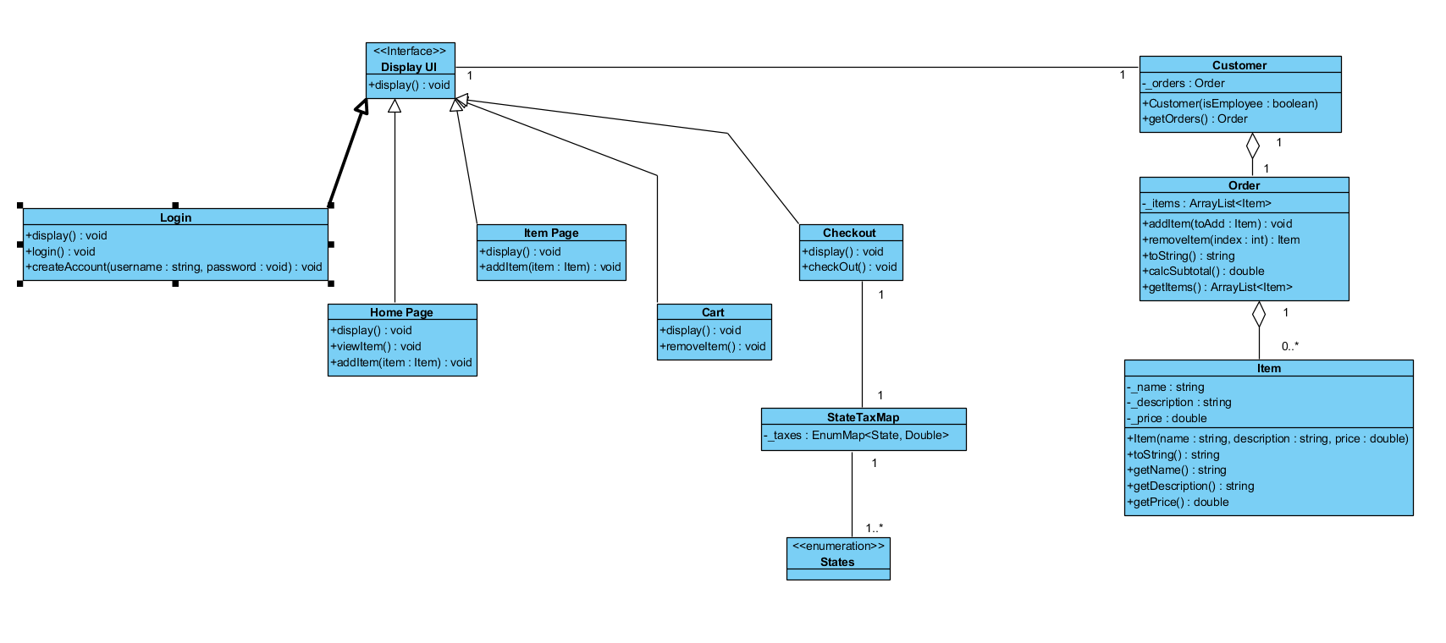
System Class Diagram

Slide 3
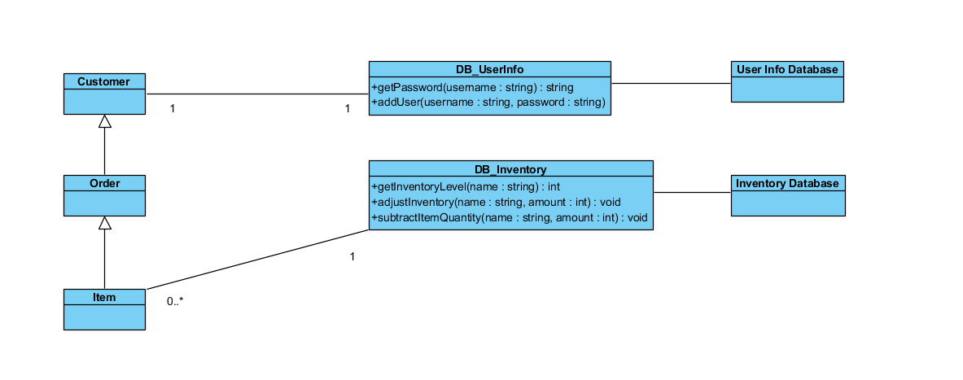
Database Diagram

Slide 4
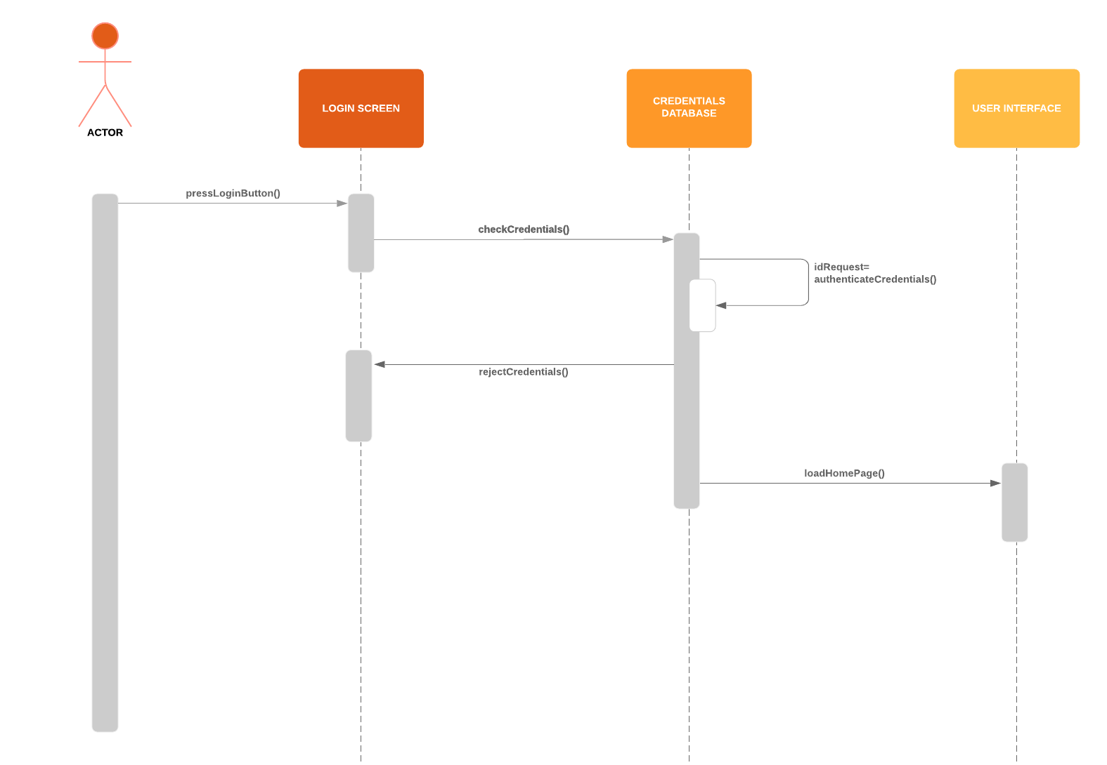
Login
Sequence

Slide 5
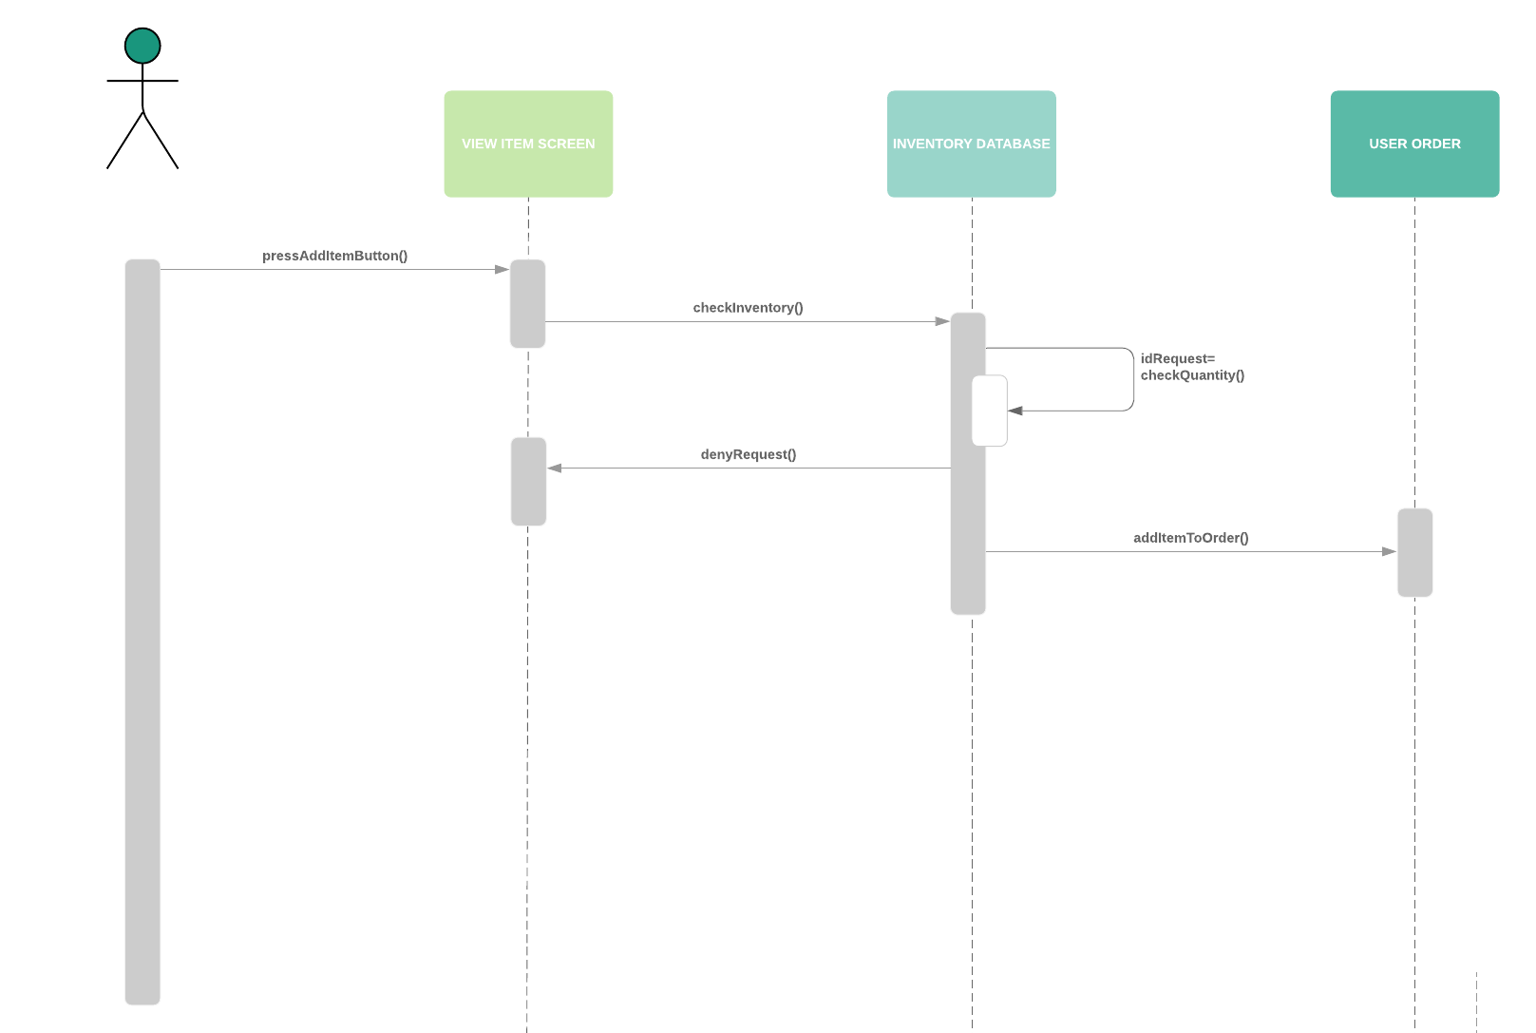
Add Item
Sequence

Slide 6

Thank you!

